Slide 1
Welcome Aboard! *Virtual Event*
Agenda
Welcome – Pledge of Allegiance & Midshipman Prayer
Introductions – Club Officers & Class of 2025
USAA – Information Packet
About the USNA Indiana Parents Club
Plebe Year 101
What’s Next – Plebe Picnic & One Shot Primer
•

Slide 2
Administrative Items
Please Mute your phone / audio
Use the Chat Room to ask questions
NOTE: This virtual meeting is being Recorded.

Slide 3
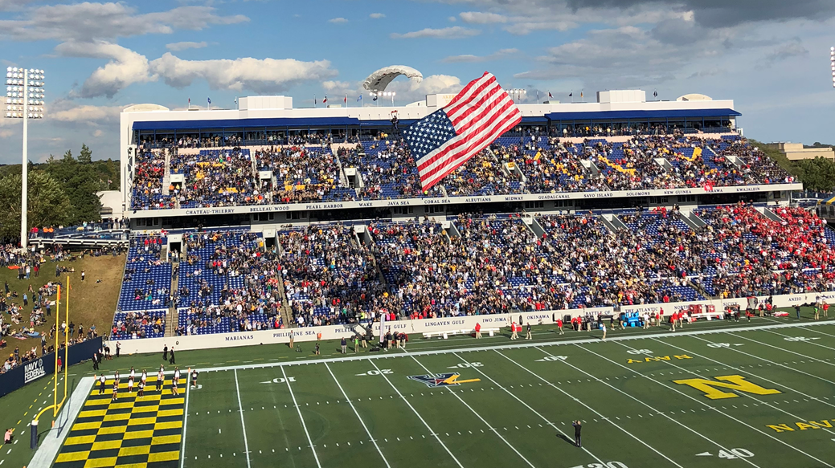
Pledge
of
Allegiance

Slide 4
The Midshipman Prayer (modified version)
Almighty God, whose way is in the sea, whose paths are in the great waters,
whose command is over all and whose love never faileth; let me be aware of Thy presence and obedient to Thy will. Keep our midshipmen true to their best selves, guarding them against dishonesty in purpose and in deed, and helping them so to live that they can stand unashamed and unafraid before their shipmates, their loved ones, and Thee. Protect those in whose love we live. Give them the will to do their best and to accept their share of responsibilities with a strong heart and a cheerful mind. Make them considerate of those entrusted to their leadership and faithful to the duties our country has entrusted in them. Let their uniform remind them daily of the traditions of the service of which they are a part. If they are inclined to doubt, steady their faith; if they are tempted, make them strong to resist; if they should miss the mark, give them courage to try again. Guide them with the light of truth and give them strength to faithfully serve Thee, now and always.

Slide 5
Club Officers & Board 2020-2021
Co-Presidents
Past Presidents & Board At Large
Sherri & Graham Torr (Jarrod ‘21)
Co- Vice Presidents
Matt Lucchese (Emma ‘25)
Mary Lucchese (Emma ‘25)
Blue & Gold Officers - Current
Kurt & Lynn Greggs
(Brian ‘17, Elizabeth ‘17)
Frank Kaiser (wife is Susanne)
(Jackson ‘22)
Secretary
Laura Hutchens (Jack ‘23)
Treasurers
Tammy Owen (Chloe ‘21)

Slide 6
Welcome Class of 2025 & NAPSter!
Brianna Baker, Fishers
Lauren Bryant, Elkhart
Olivia Calero, Brownsburg
Michael Chen, West Lafayette
Matthew Croddy, Indianapolis
Luke Dever, Bargersville
Jackson Fleming, Chesterton
Jaxon Foertsch, Santa Claus
Kathryn Jackowski, Saint John
Landon Kruer, Sellersburg
Lindsey Linville, Osgood
Emma Lucchese, Indianapolis
Griffin Martinez, Mishawaka
Devin Mockobee, Booneville
William Schneider, Fort Wayne

Slide 7
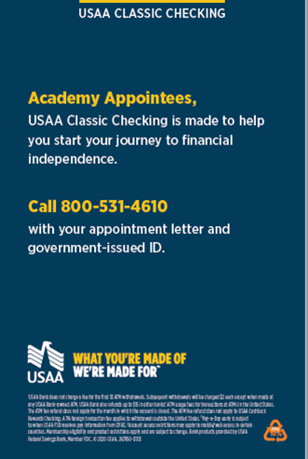
USAA
Office is across the street from GATE 1
Renter’s insurance for USNA midshipmen – Highly Recommend!
Refer to handouts for additional information about checking plans, etc.

Slide 8
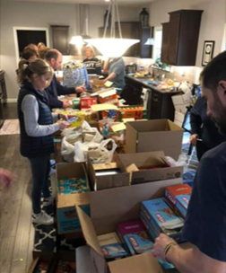
About the USNA Parents Club of Indiana
Supports the Midshipmen, Graduates & their Families
Plebe Welcome Aboard Picnic & Informational Materials
USNA Football Viewing Parties
Dark Ages Care Packages
Birthday Cards & Gifts
Graduate Recognition
All Academy Ball
Class Challenge Coin Sale
Pizza Party on the Yard during 2/C Parents Weekend
Snack Bags for MIDs traveling via bus to South Bend for USNA vs. Notre Dame football
Coming Soon…
Activities to support our graduates in the Fleet

Slide 9
How Do I Join?
- Complete the Application Form
- Mail the Form & Payment to:
Tammy Owen
2837 Sleeping Ridge Way
Indianapolis, IN 46217
Or,
Submit Form & Payment at the Plebe Welcome Aboard Picnic
**Special Offer**
Join by August 15 To Be Entered in a Drawing for 2 tickets to the All Academy Ball, December 23rd at the Indiana Roof Ballroom

Slide 10
Other Ways To Help?
Amazon Smile
Amazon donates 0.5% of the price of eligible AmazonSmile purchases to our Club
smile.amazon.com/ch/31-1241952
Kroger Community Rewards
Link your Kroger Card to our organization
coming soon…check your email
https://www.kroger.com/i/community/community-rewards
Get Involved – Join a Committee - Host An Event in Indiana or on the Yard

Slide 11
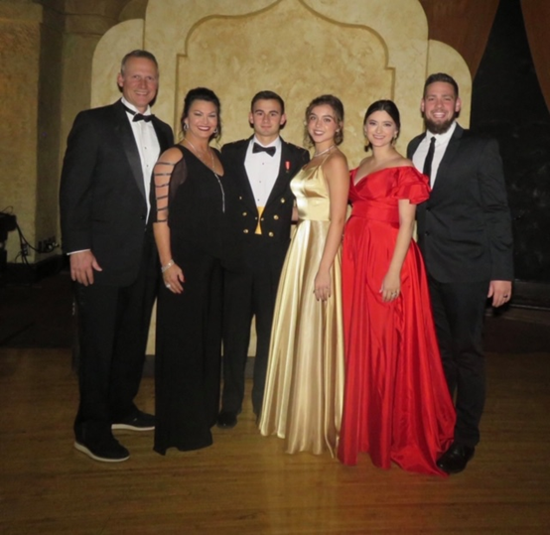
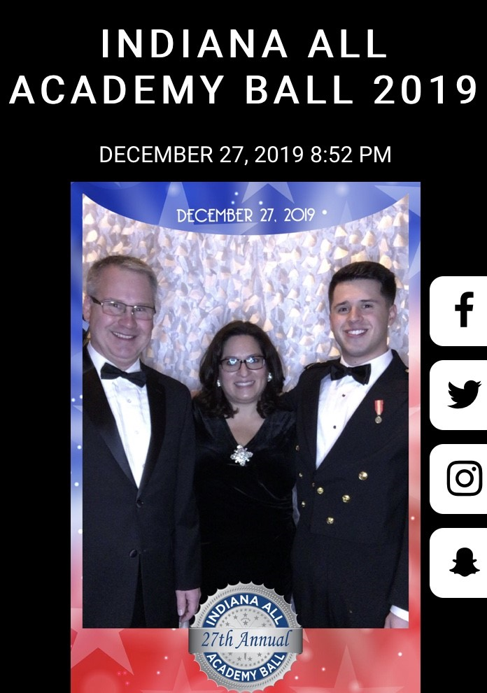
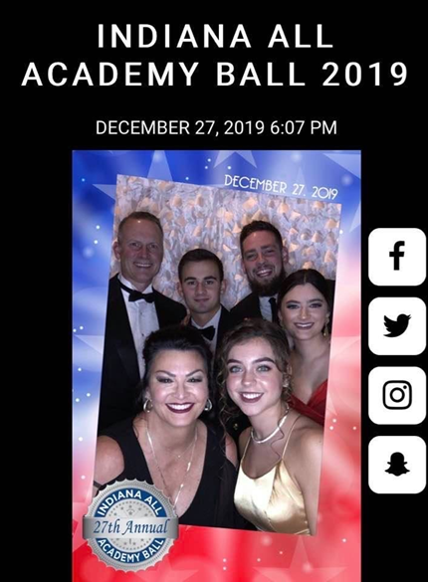
Indiana All Academy Ball
SAVE THE DATE!
23 December 2021
Indianapolis Marriott – Downtown
Annual Fundraising Event
We need your help! Contact Tammy Owen

Slide 12
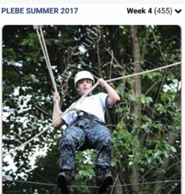
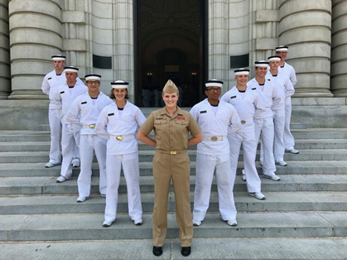
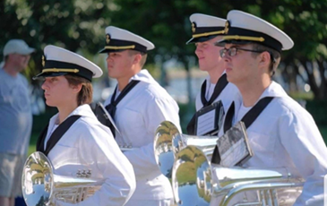
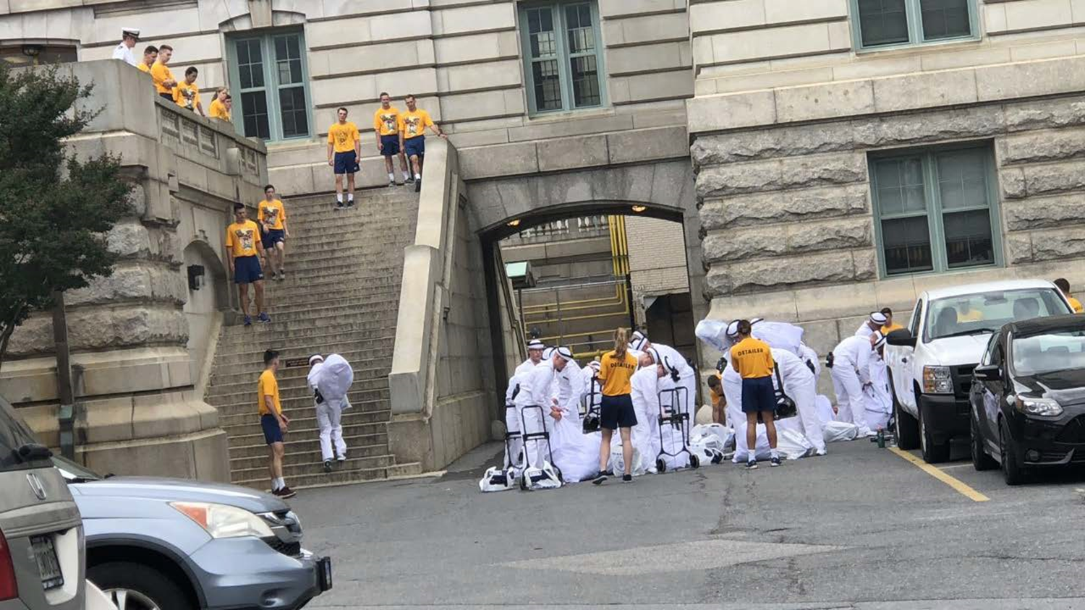
Plebe Year 101 - Agenda
Induction Day (I-Day) Readiness
I-Day Plebe & Parent Info
Summer Mail & Care Packages
Summer Phone Calls
Plebe Parent Weekend (PPW)
Sponsor Families
Holiday Travel
Herndon Climb

Slide 13
I-DAY Readiness: To Do - Plebes
Complete USNA Permit to Report Paperwork & Keep Copies
Get a Haircut
Get a Mask
Get a Passport
Request a Sponsor Family – Be Specific and Honest
Immunizations
Daily Workouts! Push-Ups!!
Break-in Running Shoes
Plan 3 Phone Calls
Memorize Chain of Command & Academy Mission Statement

Slide 14
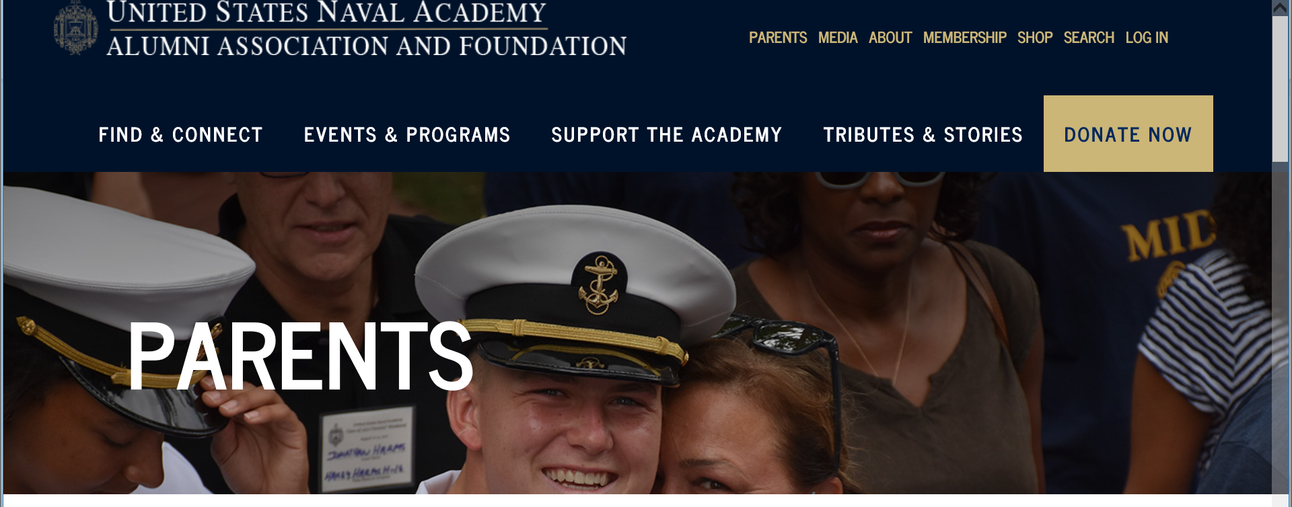
I-DAY Readiness
TO DO - PARENTS
Hotel Reservations (I-Day & PPW)
Join the Alumni Association – Includes Access to the Summer Photo Program*
Plan Care Packages With Your Plebe (Shoes, socks, underwear)
Ask Friends and Relatives To Send Mail – Provide Guidelines
*USNA Parent Dashboard
https://www.usna.com/ptr?fbclid=IwAR26p0Khl3NQ3lPYt5f1NKORjiKRI2uUZC7TA0ZfSPMcA2BPuC-ZjfKtjyc

Slide 15
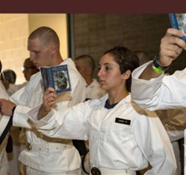
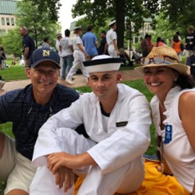
I-DAY Plebe Info
Bring Paperwork, Cell Phone, Charger, Wallet, Cash (≤$100) Calculator, Backpack, Broken-In Running Shoes & a Mask
Eat Breakfast!!
Report To Alumni Hall At Designated Time
Lunch & snacks provided by USNA

Slide 16
Plebe Summer – Mail & Care Packages
Plebes Love Pictures, Notes & News From Home
Detailers Inspect Package Contents But Will Not Open Sealed Envelopes
Packages Arrive Sooner Than Letters
Send Healthy One-Serve Snacks
Send Small Containers That Seal
Send Extra Care Packages to the Chaplain for “Any Plebe”
DO NOT
Send Contraband – Junk Food, Electronics, Flashlights
Send Confetti or Anything That Requires Clean-Up
Draw Attention to Your Plebe

Slide 17
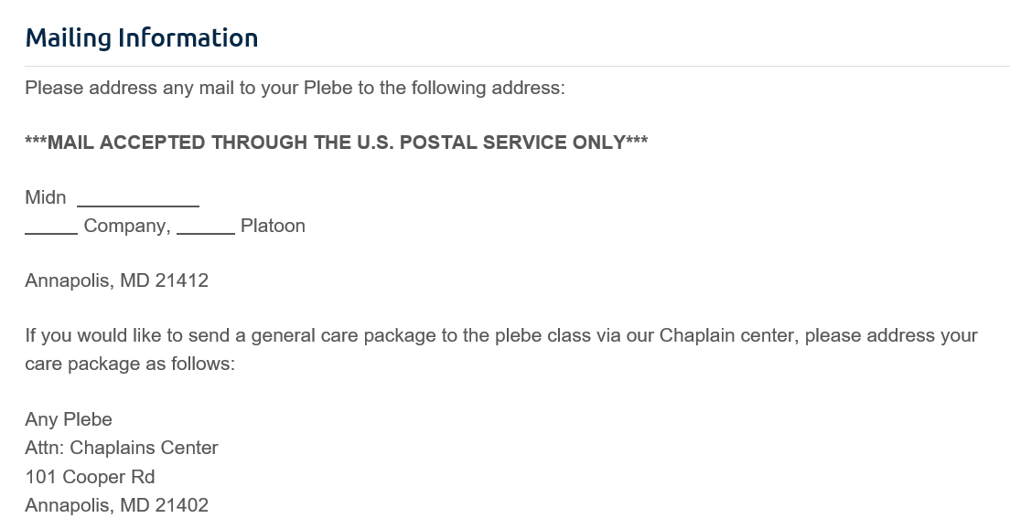
Plebe Summer – Mail & Care Packages

Slide 18
Plebe Summer - Phone Calls
PARENTS - TO DO
Be Available At Designated Call Times – It May Be A Time Range
Practice “Conference Calls” In Advance, If Applicable
Keep a List of Discussion Topics For the Call - Local News, Updates on Friends, Etc.
Keep Questions Simple – Ask About New Friends, Food, Roommates
Sometimes Reception Is Sketchy Since So Many Plebes Are Calling At Once
PHONE CALL PROCESS
Detailers Charge Cell Phones
Plebes Line Up on Field
Plebes Call At A Designated Time
Detailers Count Down Near End Of Call
Calls End Exactly At Designated Time

Slide 19
Plebe Parent Weekend
Bring the Family to PPW if Possible
Watch Plebes Drills–Bancroft Hall
Attend Parent Briefing–Alumni Hall
Visit Dorm Rooms–Rare Opportunity
Attend the Parade–Worden Field
Plebes Want to Get Off the Yard
Expect Your Plebe to Eat, Sleep, and Phone Friends
Consider renting a home versus hotel
Support Plebes Without Family This Weekend

Slide 20
Plebe Sponsor Families
Why Have a Sponsor Family?
Home Away From Home
Support & Encouragement
To Get Off the Yard
Sleep and Eat Good Food
Lifelong Friendships

Slide 21
Holiday Travel
Plebes Travel in Uniform
Must submit request to travel through Chain of Command
International Travel = Earlier Request Deadlines
Buy Airplane Tickets With No Change Fees (Southwest)
Plebes Will Know Leave/Report Times – Published Schedules Are Always Subject to Change
Flights Should Land 5 Hours Before Report Time
Sponsor Families Often Volunteer To Provide Airport Transportation

Slide 22
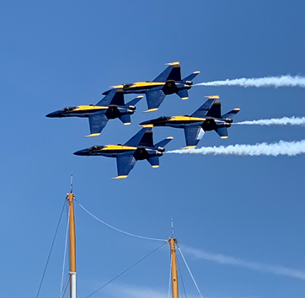
Herndon Climb
Final Event of Plebe Year
Teamwork & Perseverance
Climb the 21-foot obelisk
Remove the “dixie cup” hat and replace it with an upperclassman cover
Reserve Hotels Early – This Is Graduation Week
Help Your Youngster Move Out of Bancroft Hall
Watch the Blue Angels Rehearsal
PLEBES NO MORE!
Class of 2022 Time 1:05:05
Photo from www.msn.com

Slide 23
Suggested Resources
USNA Links for I-DAY Readiness
https://www.usna.edu/Admissions/PermitToReport/
https://www.usna.edu/Admissions/PermitToReport/0._Important_Information_Class_Of_2024_-_UPDATED_5-26.pdf
Websites
https://www.usna.edu/PlebeSummer/index.php
https://www.usna.edu/PlebeParentsWeekend/
https://indianausnaparents.org
https://www.usna.com/events-and-programs
Instagram
@usnacommandant
@usna.plebesummer.classof2024
Facebook
USNA Parents Club of Indiana
USNA MID Moms!!! (and Dads!)
Parents of USNA Class of 2024
Army Navy Game Ticket Exchange
Company Pages (e.g. USNA 8th Company)
Other
AcademyFamiliesTravelNetwork@gmail.com

Slide 24
Final Thoughts
Your Plebe Can Do This!
Provide Support and Encouragement
Send Notes, Photos & News
Be thoughtful about posting on Social Media
Everyone Wants Your Plebe to Succeed – The Academy, Detailers, BGOs, Parents Club Members, etc.
“Your MID is My MID”
Everything is New This Year Due to COVID-19
SEMPER GUMBY!

Slide 25
Q&A
Please use the Chat Room to ask questions

Slide 26
WRAP-UP & THANK YOU!
***REMINDER – Plebe Picnic In-Person June 12 @ 11 am***
Midshipmen in Attendance Today
Youngster Parent Volunteers
Blue & Gold Officers

Slide 27
Traditional
USNA I-Day
Family Picnic & Information Expo
P
Mid Store $$$$$
Alumni Hall Class of 2024 Processing
Dahlgren Hall
King George Street
USNA Visitors’ Gate (Gate 1)

Slide 28
Plebe Practice

Slide 29
Plebe Practice
Can you name this USNA
statue that is decked out in “war paint” for football games and special occasions?

Slide 30
Plebe Practice
Who are the people in the gold shirts giving instructions?

Slide 31
Plebe Practice
What famous US Senator (USNA ’58), pilot, and Vietnam POW was laid to rest in the USNA cemetery in August 2018?

Slide 32
Plebe Practice
What animal serves as the USNA Mascot and what is his name?

Slide 33
Plebe Practice
Complete this phrase:
GO NAVY, BEAT !

Slide 34
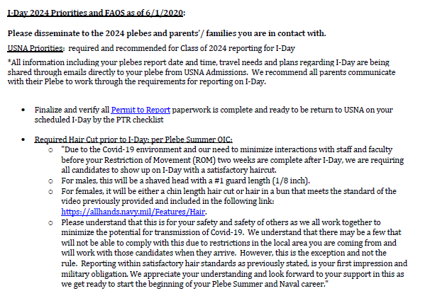

Slide 35
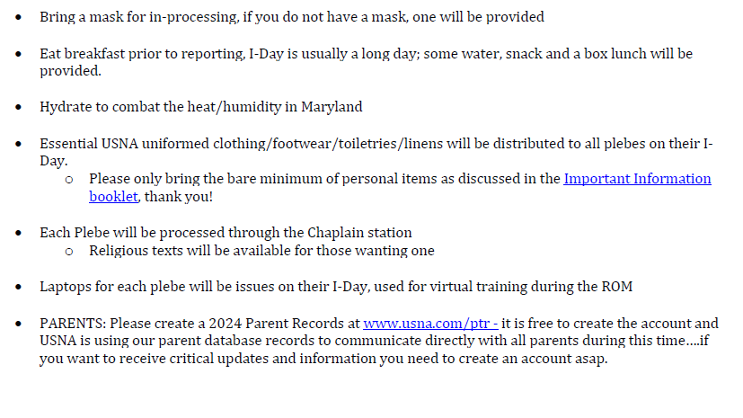

Slide 36
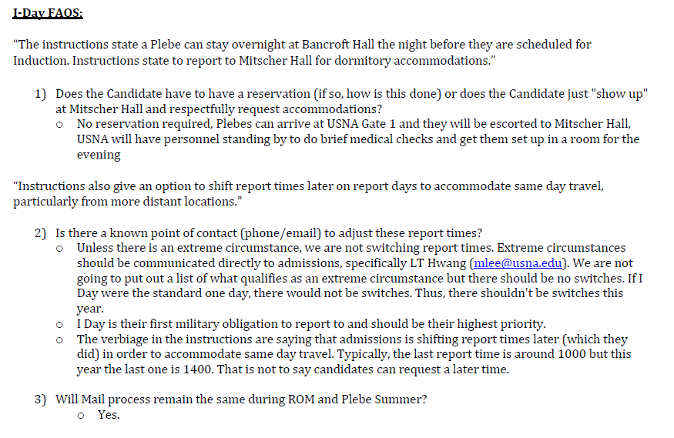

Slide 37
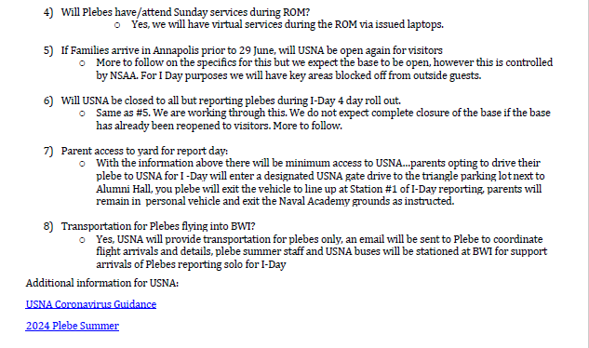

Slide 38
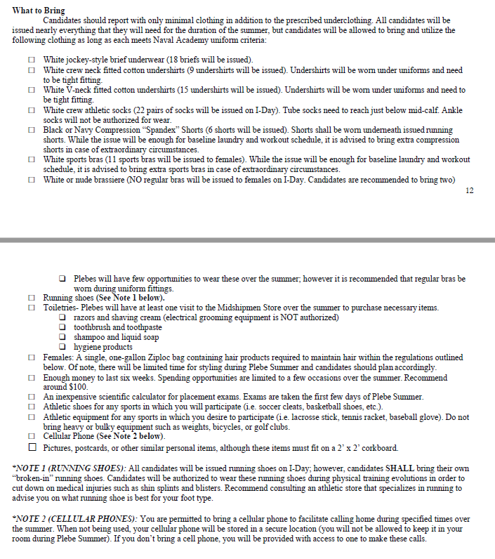

Slide 39
